Slide 1
Gym Modernization: Del I
By Alek, Akram, Daniel, Jay, Tom, PK

Slide 2
Background
Kensington, Maryland is home to many gyms. The premiere one is Anytime Fitness which is open to 24/7 to members.
Their front end UI/UX is highly sophisticated and eye catching- https://www.anytimefitness.com/gyms/1960/kensington-md-20895/
Our client, Rock Creek Sports Club would like to meet with us to request a system which will allow their members an easy check in process using tokens/fobs.
We will be implementing a personal member profile page which allows them to keep track of their hours spent at the gym, the ability to make/view appointments, personal fitness goals, online payment option (using a TPS) and an option to allow them to communicate with other members in the form of a social media interface.

Slide 3
Technical Feasibility

Slide 4
Technical Feasibility
The main distinct feature that will affect development is that we will be developing the system as multiple networked parts that are written across two main coding languages. We will also be using scripting and markup languages as secondary tools in our development process.
Another distinct feature that will affect development is making the system accident-resistant.
Overzealous use of the system should not be able to break it. However, protecting the system while retaining its usability will require careful consideration and repeated testing.

Slide 5
Technical Feasibility - Familiarity with Application
Mitigating Sources of Technical Risk:
Potential lack of familiarity with cloud platforms, backups, online payments systems, and programming are mitigated by handling system handshakes behind the scenes of the application.
Users (Gym Staff) will interact with the system via gui-based desktop application.
The system will be developed with a Java application front-end which interacts with the database management system through PL/SQL.
Users only need to be able to navigate menus with a mouse and do basic data entry with a keyboard.

Slide 6
Technical feasibility - Familiarity with Technology
System will use Cloud based CRM which our Technical Director is familiar with.
End users expected to understand the basic functionality of input (keyboard, mouse).
Must be comfortable with working on a Microsoft Windows platform and navigating file systems.
Basic understanding of spreadsheets and identifying member statuses.

Slide 7
Technical Feasibility - Project Size
Our current, and building, team experience with the required coding indicate a feasible system design.
Overall small project size given the size of the current location. The plans of expanding to a second larger facility will not affect this current project.
Our team has six members. We have a time frame of fourteen to sixteen weeks to cover planning, analyzing, prototyping, finalizing design, and implementing our system.
Notes:
The new Modernization system is completely replacing old systems. Data stored in simple hard-coded, locally-hosted spreadsheets will be moved to the database and accessed via the application program.
Patrons will quickly and easily check-in through the scanner system.

Slide 8
Economic Feasibility

Slide 9
Operating Costs
Electricity to run scanners
Scanner maintenance
Updating and patching software
Additional Scannable cards

Slide 10
Intangible Benefits
Takes headcount of people in gym
Know how crowded gym without having to be there
Shows busiest and slowest times to find optimal business hours
Helps prevent people from entering with old cards from canceled memberships
Gives statistics of gym use

Slide 11
Development Costs
$200 (4X) - Card Scanners
Pay for Software developers
$304.50 (250)- Scannable cards
Database storage and development in mySQL.
Data warehousing storage solution.

Slide 12
Annual Benefits
$8,600 - Increased revenues
$2,400 - External Audit savings
$1,500 - Overhead expense savings
Using Google Cloud Platform gives RCSB cost savings on future expansions as GCP offers significant Committed Use and Sustained Use discounts on their servers.
Another cloud savings will be the use of only 50% Reserved Instances compared to peak server usage. Half will be on-demand and inactive costs during normal expansion.

Slide 13
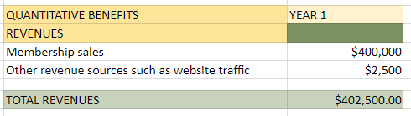
Annual Benefits

Slide 14
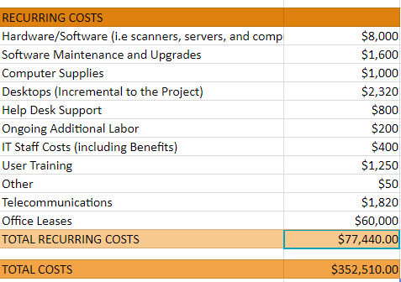
Annual Costs

Slide 15
Organizational Feasibility

Slide 16
Senior Management
Bookkeeping less error prone
Quick statistics and useful information for decision making
System is easy for management to maintain
The data is tangible at moments notice
Storage for records move away from physical copies
Gathering data from multiple locations for review simplified

Slide 17
Users
Employees (ie personal trainers, sales) will easily log and track clients
Users will flock to the system
Card system will make it easy to scan in and out
Will be able to see the hours the gym is busy

Slide 18
Other Stakeholders
Successful implementation will match benefits of other gyms
Can lock in our client base with features competitors do not offer
Investors will be influenced by technique
Will appeal to form alliances (Recreational Sites, Apparel manufacturers etc) thus giving us a more competitive advantage for our members.

Slide 19
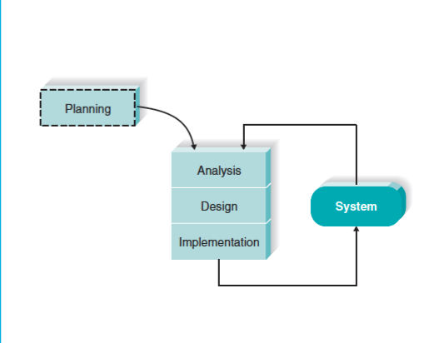
Agile Methodology
Uses of XP Techniques
Significant End-user centered involvement
Requirements are subject to minor changes as the business is willing to welcome new ideas throughout the development
Will encompass some of the iterative techniques.

Slide 20
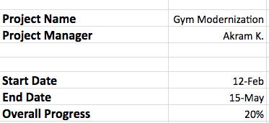
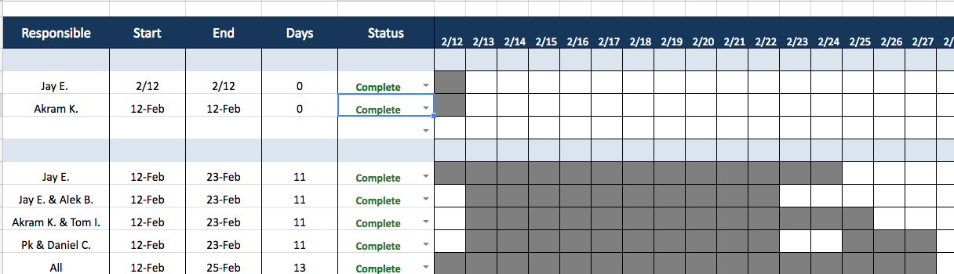
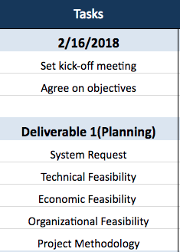
Project Workplan - Deliverable 1

